Slide 1



Web Warriors
By: Suri, Makayla and Prakrirtiey

Slide 2
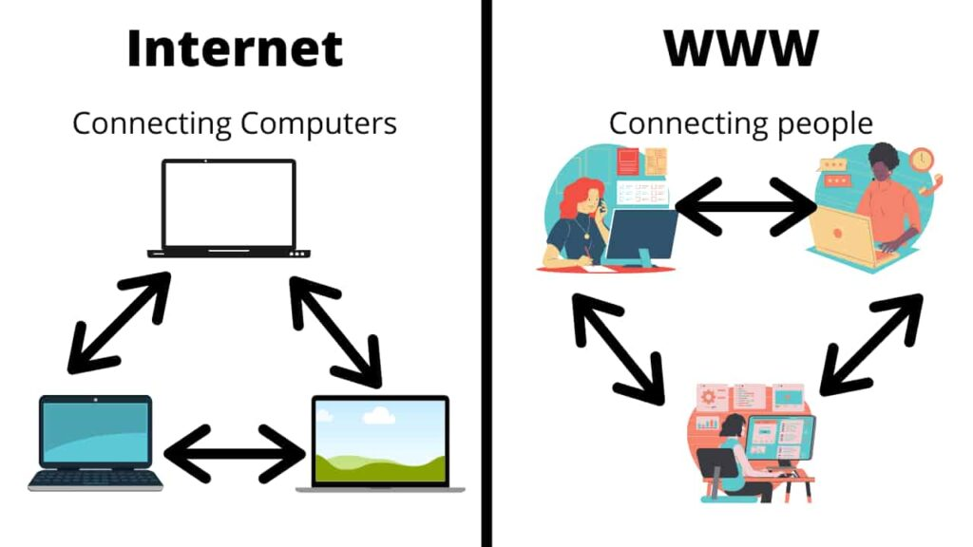
Definition of the World Wide Web
The World Wide Web is a system of interlinked documents and multimedia content that you can connect to over the internet, using web browsers. It lets users view and interact with information from different websites that are connected by hyperlinks. The WWW was invented by Tim Berners-Lee in 1989. The first website went live on August 6 1991.

Slide 3
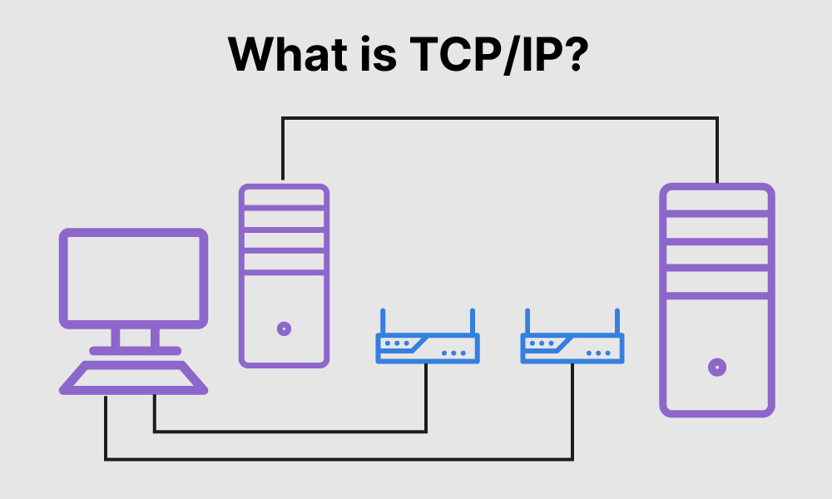
The three main internet protocols used for the worldwide web
1. Transmission Control Protocol (TCP): it's used by many core internet applications, including the World Wide Web. TCP defines the order of data transmission.
2. User Datagram Protocol (UDP): UDP ensures that it reaches the correct application running on that computer.
3. Domain Name System (DNS): This protocol translates domain names into numerical IP addresses that computers and routers use to fetch the correct websites and content.

Slide 4
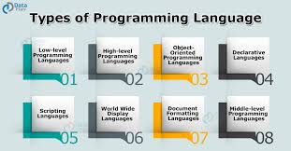
Web Programming Languages
HTML (HyperText Markup Language):
It is used to create headings, paragraphs, images, and links.
CSS (Cascading Style Sheets):
visual styling of web pages, like colors, fonts, and layout. It is used alongside HTML to make web pages look appealing.
JavaScript:
allows you to add interactivity and dynamic features to web pages, like animations, form validation, and updating content without reloading the page.
Python:
It is side server-side web development, handling backend tasks like database management, security, and application logic.
PHP (Hypertext Preprocessor):
A server-side scripting language used to manage dynamic content, databases, and session tracking.

Slide 5

Instant messaging
a message sent via the internet that appears on the recipient's screen as soon as it is transmitted.

Slide 6

Instant messaging Protocols
IRC: Group discussion in chat rooms, private messages, data transfer, and server-side and client-side commands
SMPP: SMPP (short message peer-to-peer protocol) is a telecommunications industry protocol for exchanging SMS messages over the Internet.

Slide 7

File transfer
File transfer refers to the exchange of data files, of any size or type, across computer systems and networks. According to Techopedia: “File transfer is the process of copying or moving a file from one computer to another over a network or internet connection.

Slide 8
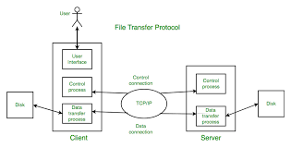
FT protocol
File Transfer Protocol (FTP)
A standard communication protocol that let users transfer files between a server and a client on a computer network. Fast BSS Transition (FT)
Also known as IEEE 802.11r or WiFi Fast Roaming, this wireless protocol allows mobile devices to transition between access points (APs) more quickly and securely. FT reduces the time spent without connectivity when a device connects to a new AP by allowing the device to re-establish security and QoS parameters before reassociating with the new AP.
SFTP, or Secure File Transfer Protocol, is a secure version of the File Transfer Protocol (FTP). It is also known as SSH File Transfer Protocol because it's based on the Secure Shell (SSH) protocol. SFTP is designed to provide a secure method for transferring files between computers on a network using encryption to ensure that the data is protected during transit.
FT allows for two options for message exchange between the client and the target AP: over-the-air or over the distribution system (DS), which is the wired network.
FTPS is a secure file transfer protocol that adds support for the TLS and SSL cryptographic protocols¹². FTPS allows you to connect securely with your trading partners, customers, and users, and authenticate them through passwords, client certificates, and server certificates². FTPS is an extension to the commonly used FTP, which uses TCP as a transport layer protocol and is good for simple file transfers¹³.

Slide 9
FTPS protocol
Uses Secure Sockets Layer (SSL) or Transport Layer Security (TLS) protocols to encrypt data in transit

Slide 10

SFTP Protocols
SFTP is commonly used by sysadmins and developers to upload and download data from test and production servers

Slide 11

Email Definition
It is an electronic email shortened to email. It is mainly used as a communication method that uses electronic devices to deliver messages across computer networks.

Slide 12

Email Protocols
The common protocols for email delivery are Post Office Protocol (POP), Internet Message Access Protocol (IMAP), and Simple Mail Transfer Protocol (SMTP)
POP is an internet standard protocol that allows email clients to retrieve emails from a mail server.
IMAP is a protocol for receiving email
SMTP s a technical standard for transmitting electronic mail email a network

Slide 13
What Is the Internet?
The Internet is a globally connected network system that facilitates communication and data services through a vast collection of private, public, business, academic, and government networks. It serves as a virtual infrastructure that links millions of computers and electronic devices worldwide, allowing users to exchange information seamlessly.

Slide 14
What is FTP, FTPS, and SFTP?
All of these thing are protocols to transfer files over a network
Each definition: FTP -File Transfer Protocol
Works over TCP/IP to transmit files over computers/remote devices
FTPS
-File Transfer Protocol Secure
Adds support to the TLS
Unlike FTP it doesn’t transmit data in clear text, it provides a secure channel for data transmission.
SFTP
Secure File Transfer Protocol
Used for security to transfer files

Slide 15
About The World Wide Web (w3.org)
World Wide Web (WWW) – GeeksforGeeks
https://ozekiphone.com/p_4398-voip-udp-vs.-voip-tcp.html
https://eluminoustechnologies.com/blog/top-10-web-programming-languages/
HTTPs://techyrick.com/world-wide-web/
https://www.techtarget.com/whatis/definition/World-Wide-Web,
https://www.ou.edu/research/electron/internet/www.htm
Compare the eight best instant messaging and chat protocols (ably.com)
https://www.geeksforgeeks.org/file-transfer-protocol-ftp-in-application-layer/
What is the Internet? Definition, Protocols & How It Works (techopedia.com)
https://www.cloudflare.com/learning/email-security/what-is-smtp/#:~:text=The%20Simple%20Mail%20Transfer%20Protocol%20(SMTP)%20is%20a%20technical%20standard,their%20underlying%20hardware%20or%20software.
https://www.atatus.com/blog/how-to-choose-the-email-protocol-imap-vs-pop3-vs-smtp/

